Slide 1
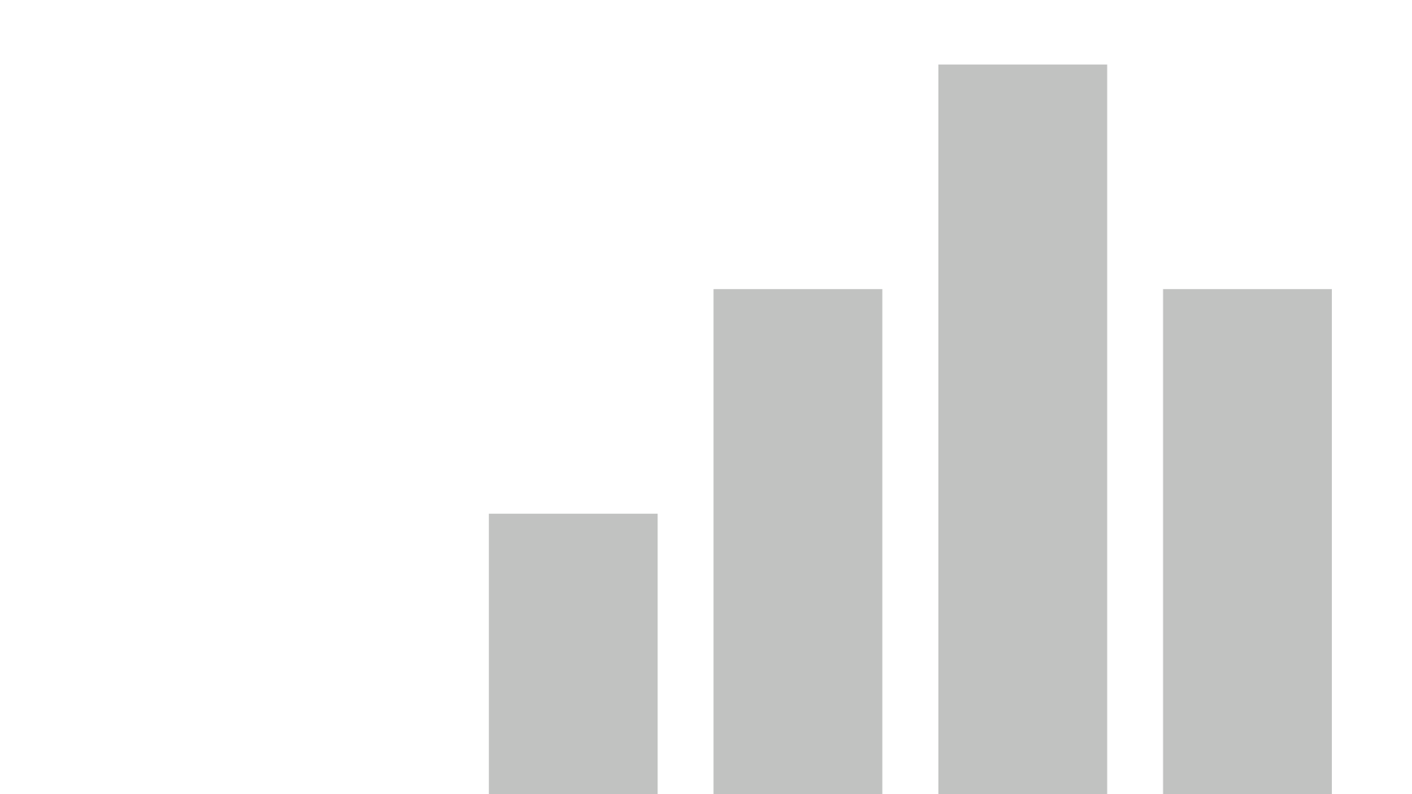

Weather Trends Visualizer
ARPAN CHATTERJEE
2312RES162
IITP000646
DATA SCIENCE PROJECT 2 (GUVI HCL)
arpan_2312res162@iitp.ac.in
4th Semester BSc CSDA
Github: https://github.com/ArpanC03/GuviProject2DataScience
Colab: https://colab.research.google.com/drive/1xApbaj9PFJoNHeqZisF6BLhwWF4SXGV0#scrollTo=zvJ9zB6yMtI0
View in Power BI

Slide 2
Overview
This project focuses on analyzing and visualizing monthly weather patterns using historical data. By leveraging popular Python libraries such as Pandas for data manipulation and Plotly for interactive plotting, the project demonstrates how to extract meaningful insights from daily records of temperature and rainfall. The key objective is to provide an easy-to-understand, graphical representation of weather trends for each month of the year.
Data Preparation
The dataset used in this analysis consists of daily entries capturing the date, recorded temperature, and precipitation values. To ensure robust insights, preprocessing steps included converting date columns to datetime format, managing missing or inconsistent data, and identifying the specific month for each entry. This structured approach allowed for effective grouping and filtering of data, setting the stage for accurate monthly trend analysis.
Visualization Methodology
For visualization, the project employs Plotly’s powerful charting capabilities in combination with ipywidgets for interactivity. Users can interactively select a month from a dropdown menu, prompting the system to display that month’s temperature and rainfall trends. The temperature values are depicted using a line chart, while rainfall data is presented as overlayed bars. This dual representation helps reveal correlations and anomalies within each month’s weather patterns.

Slide 3
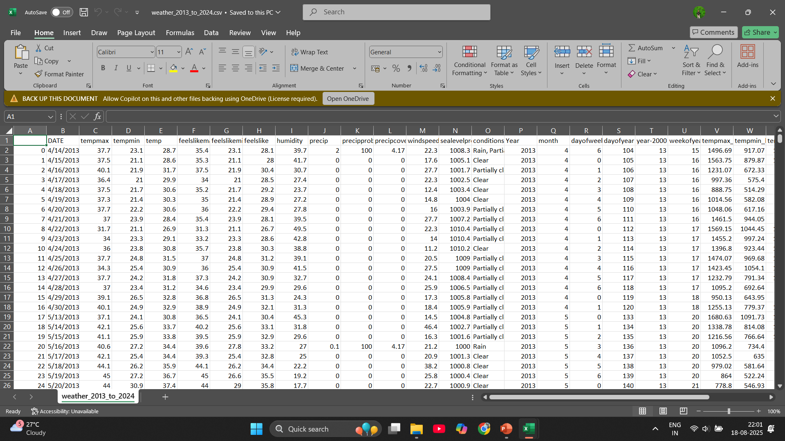

Slide 4
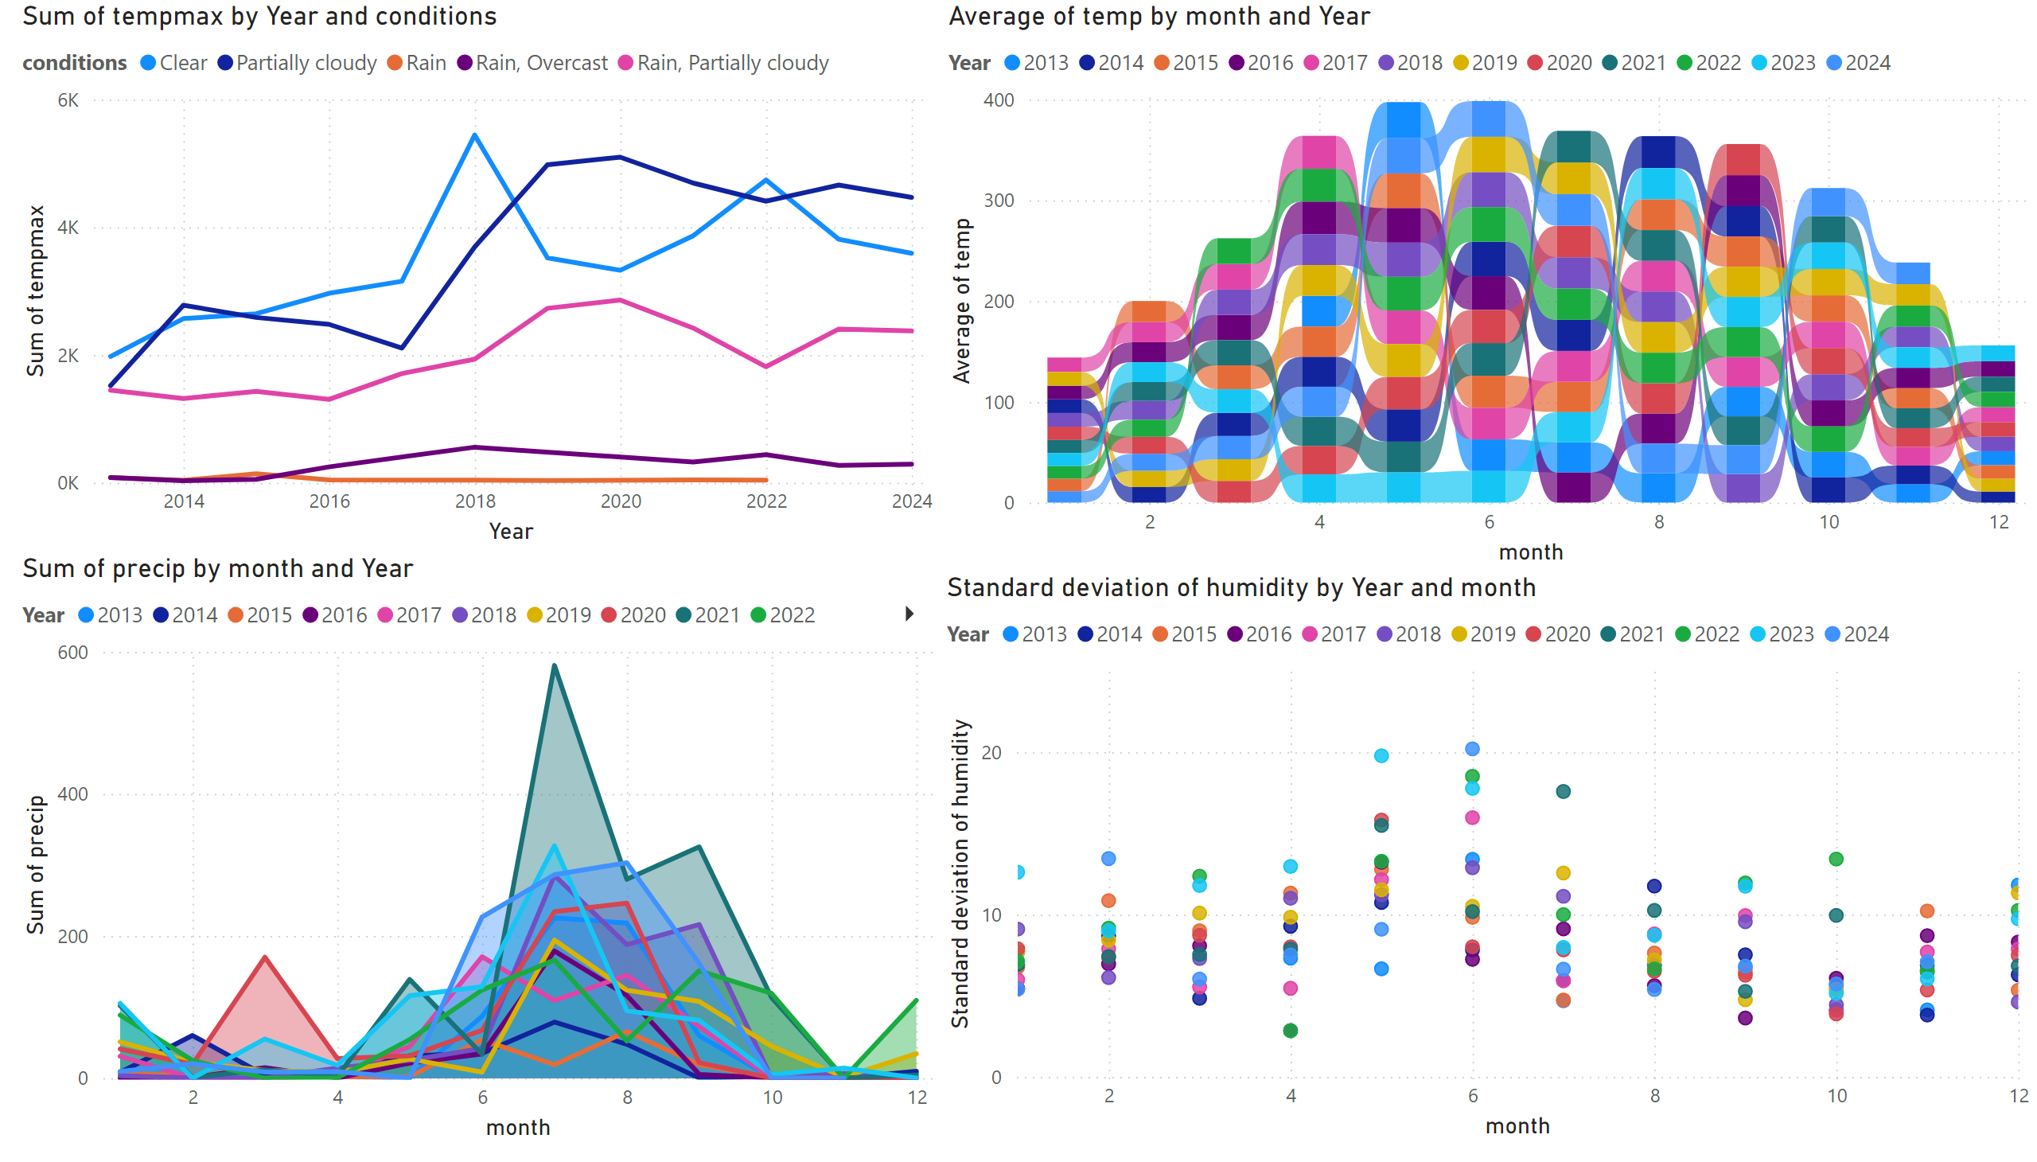
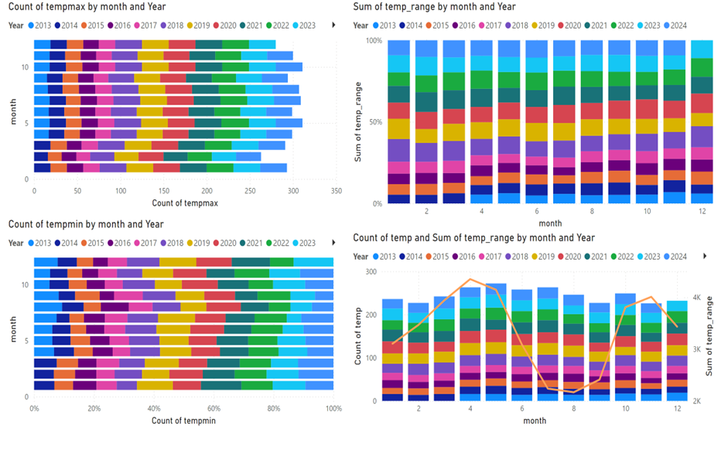
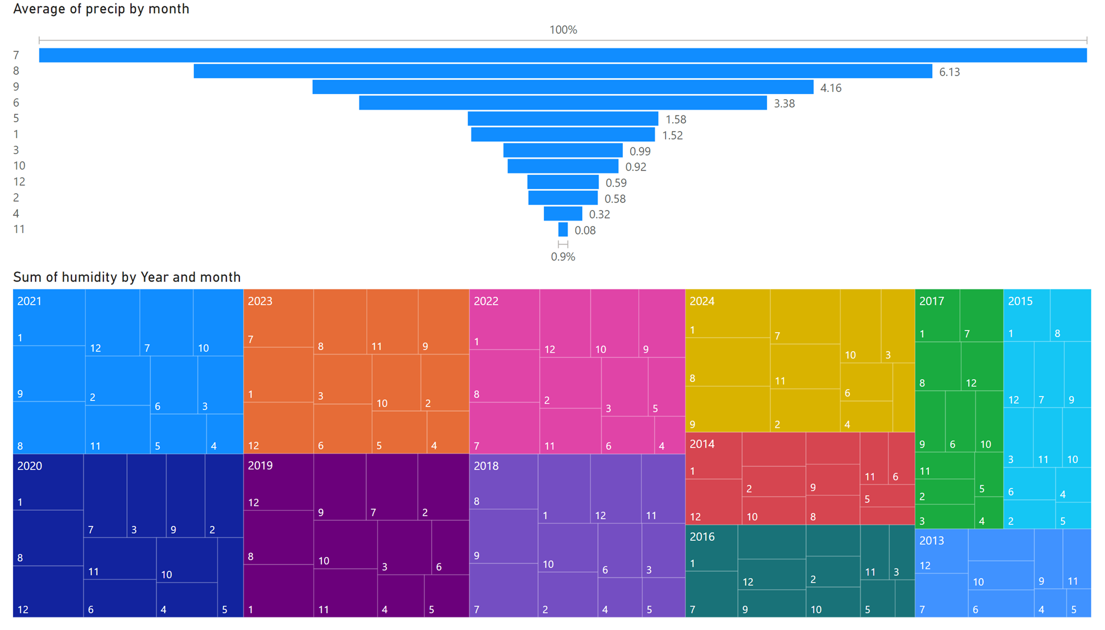
Page 1
Notes:
lineChart
No alt text provided
ribbonChart
No alt text provided
areaChart
No alt text provided
scatterChart
No alt text provided

Slide 5
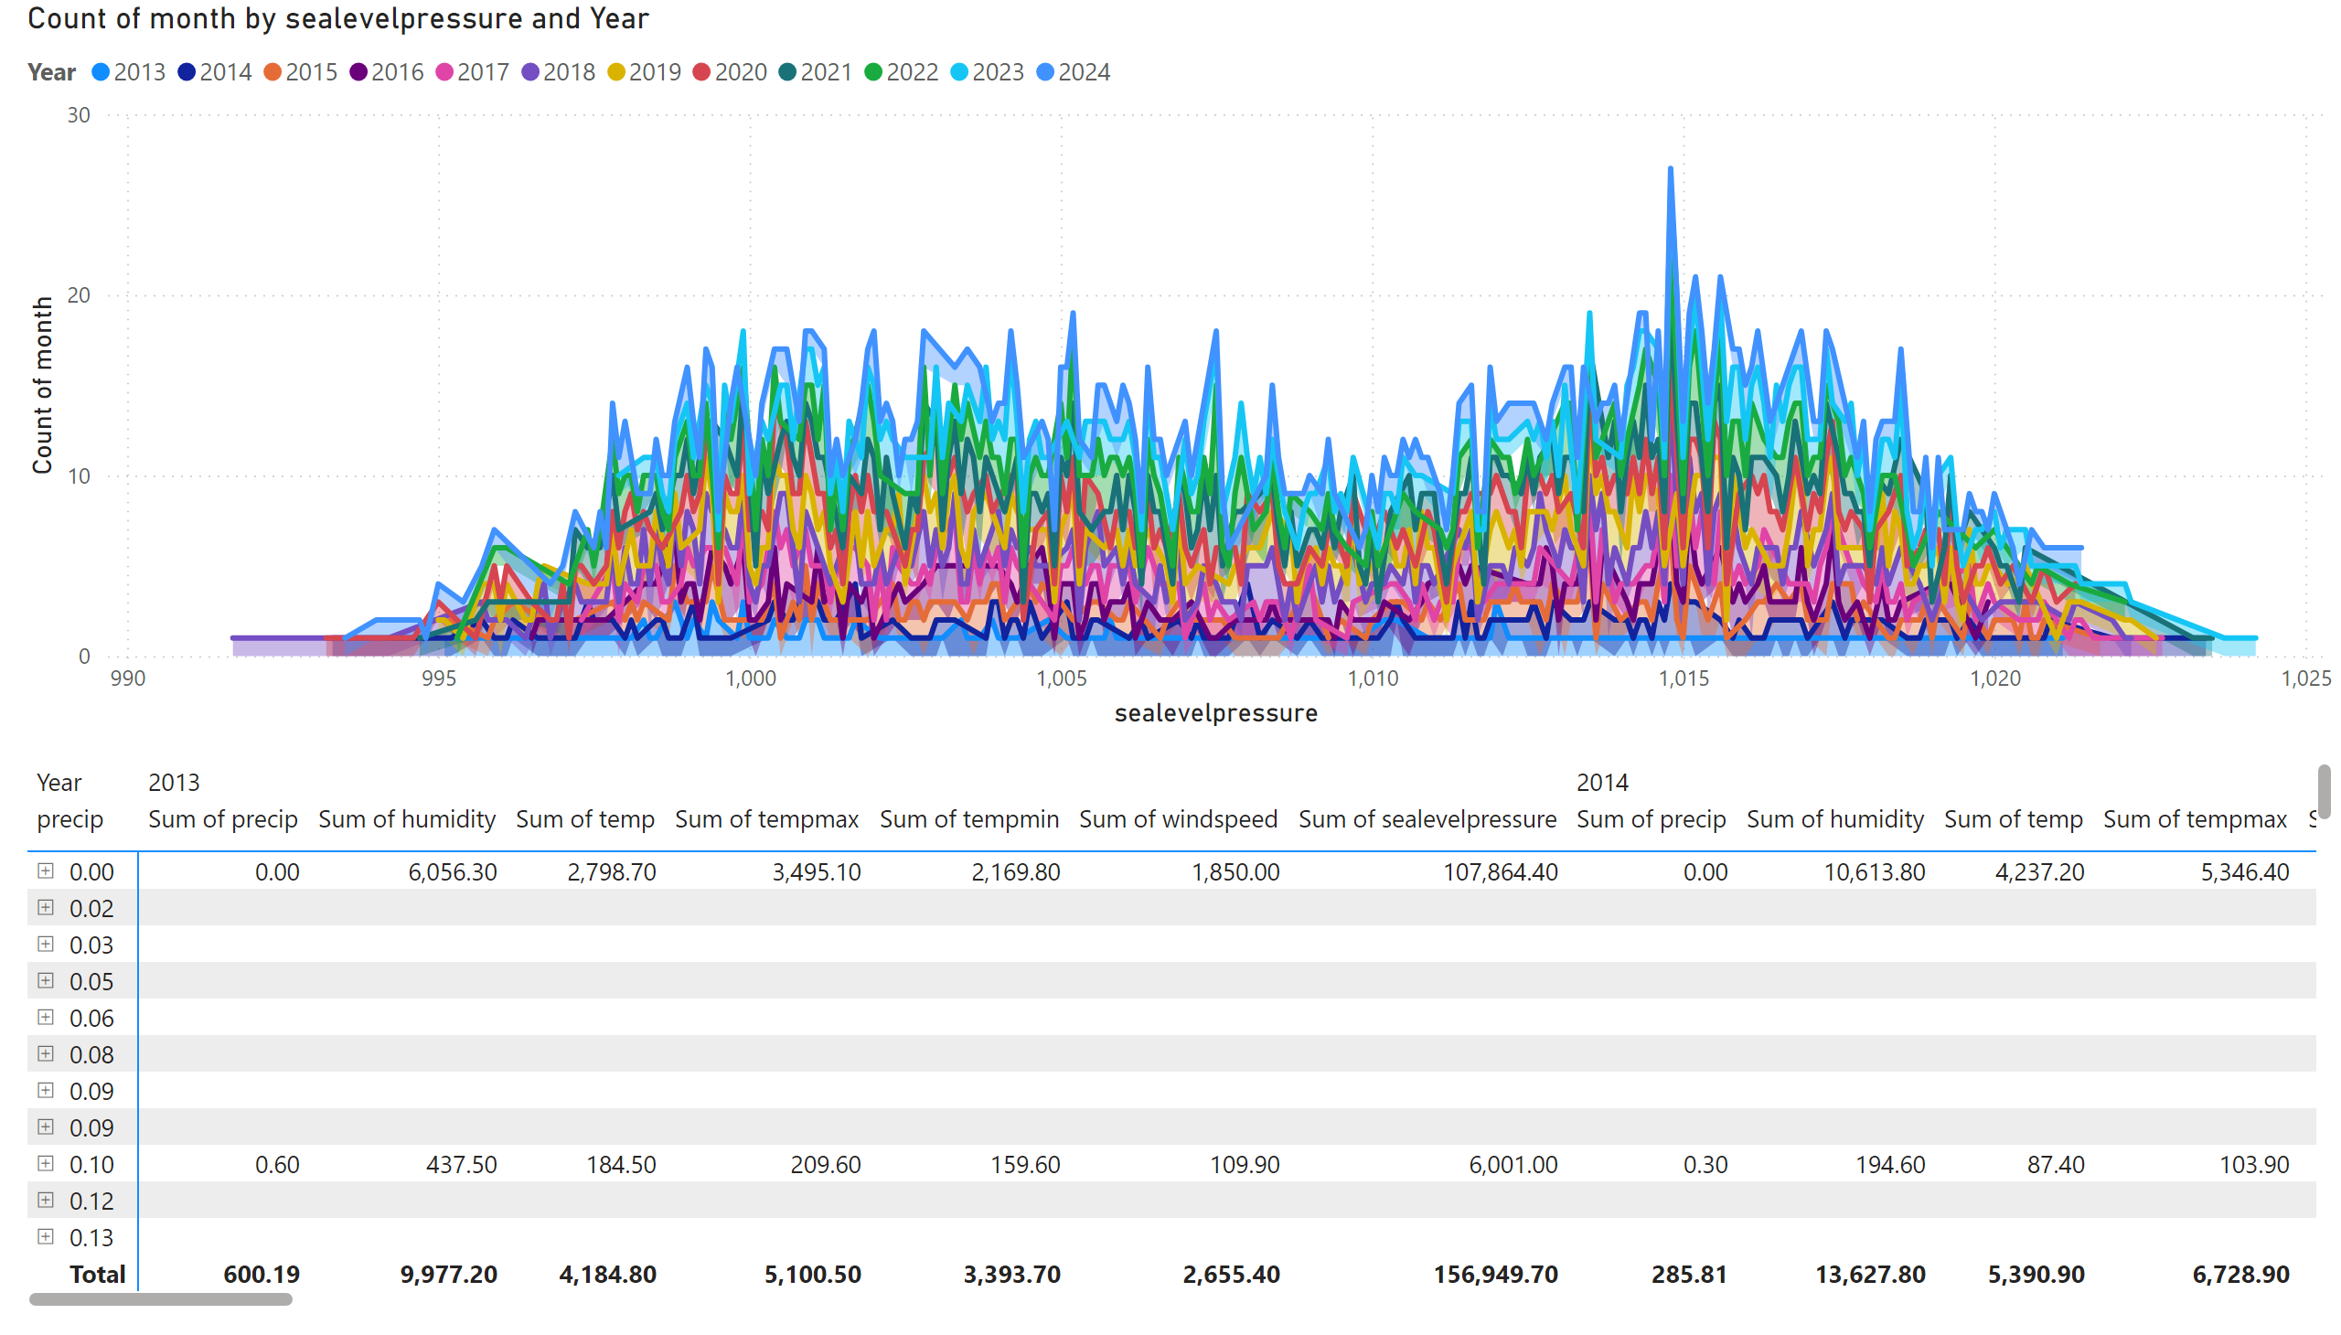
Page 4
Notes:
stackedAreaChart
No alt text provided
pivotTable
No alt text provided

Slide 6
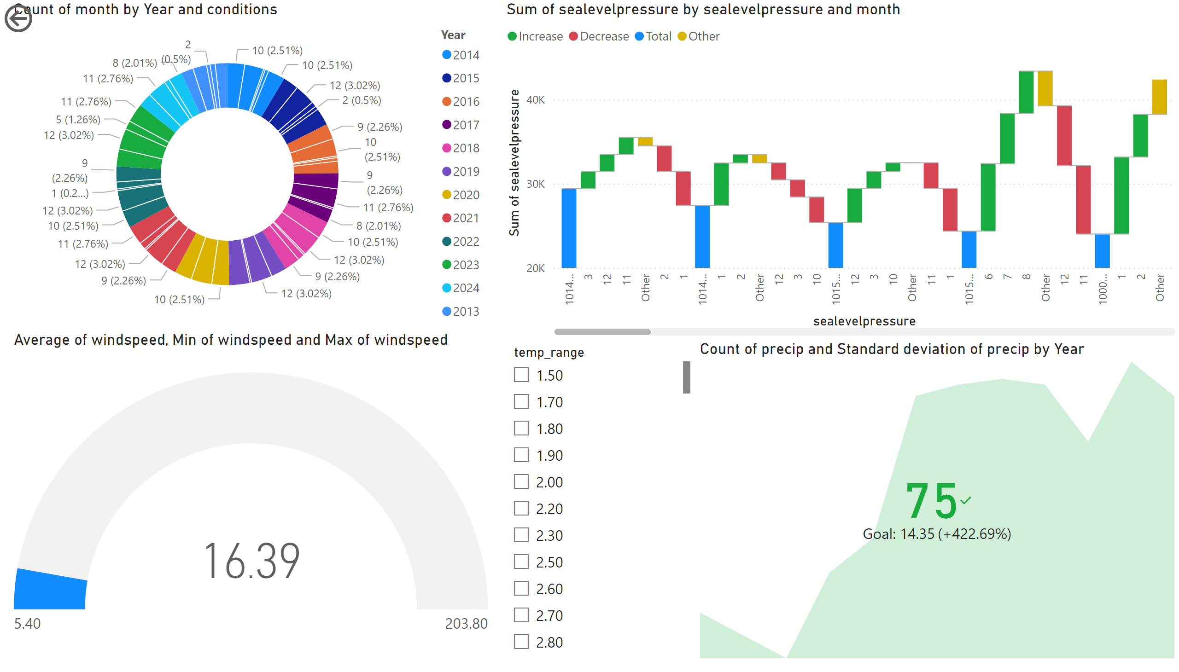
Page 5
Notes:
donutChart
No alt text provided
gauge
No alt text provided
waterfallChart
No alt text provided
slicer
No alt text provided
actionButton
No alt text provided
kpi
No alt text provided

Slide 7
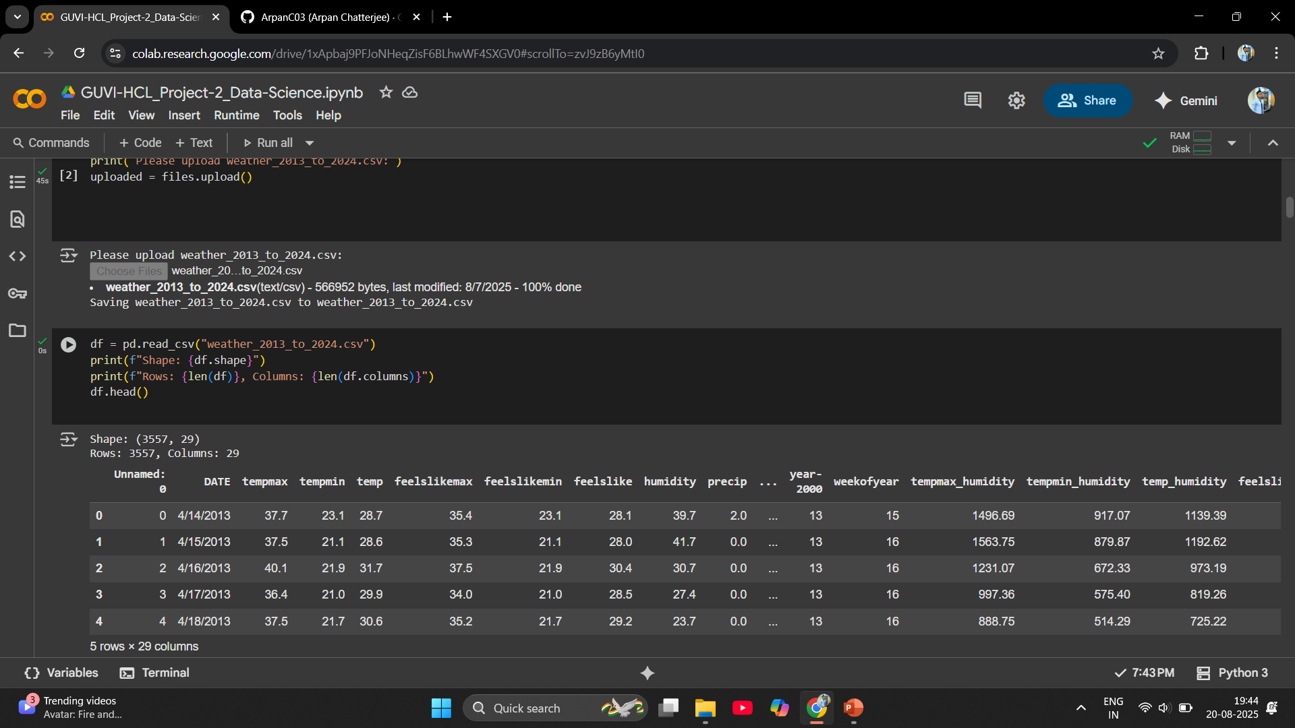
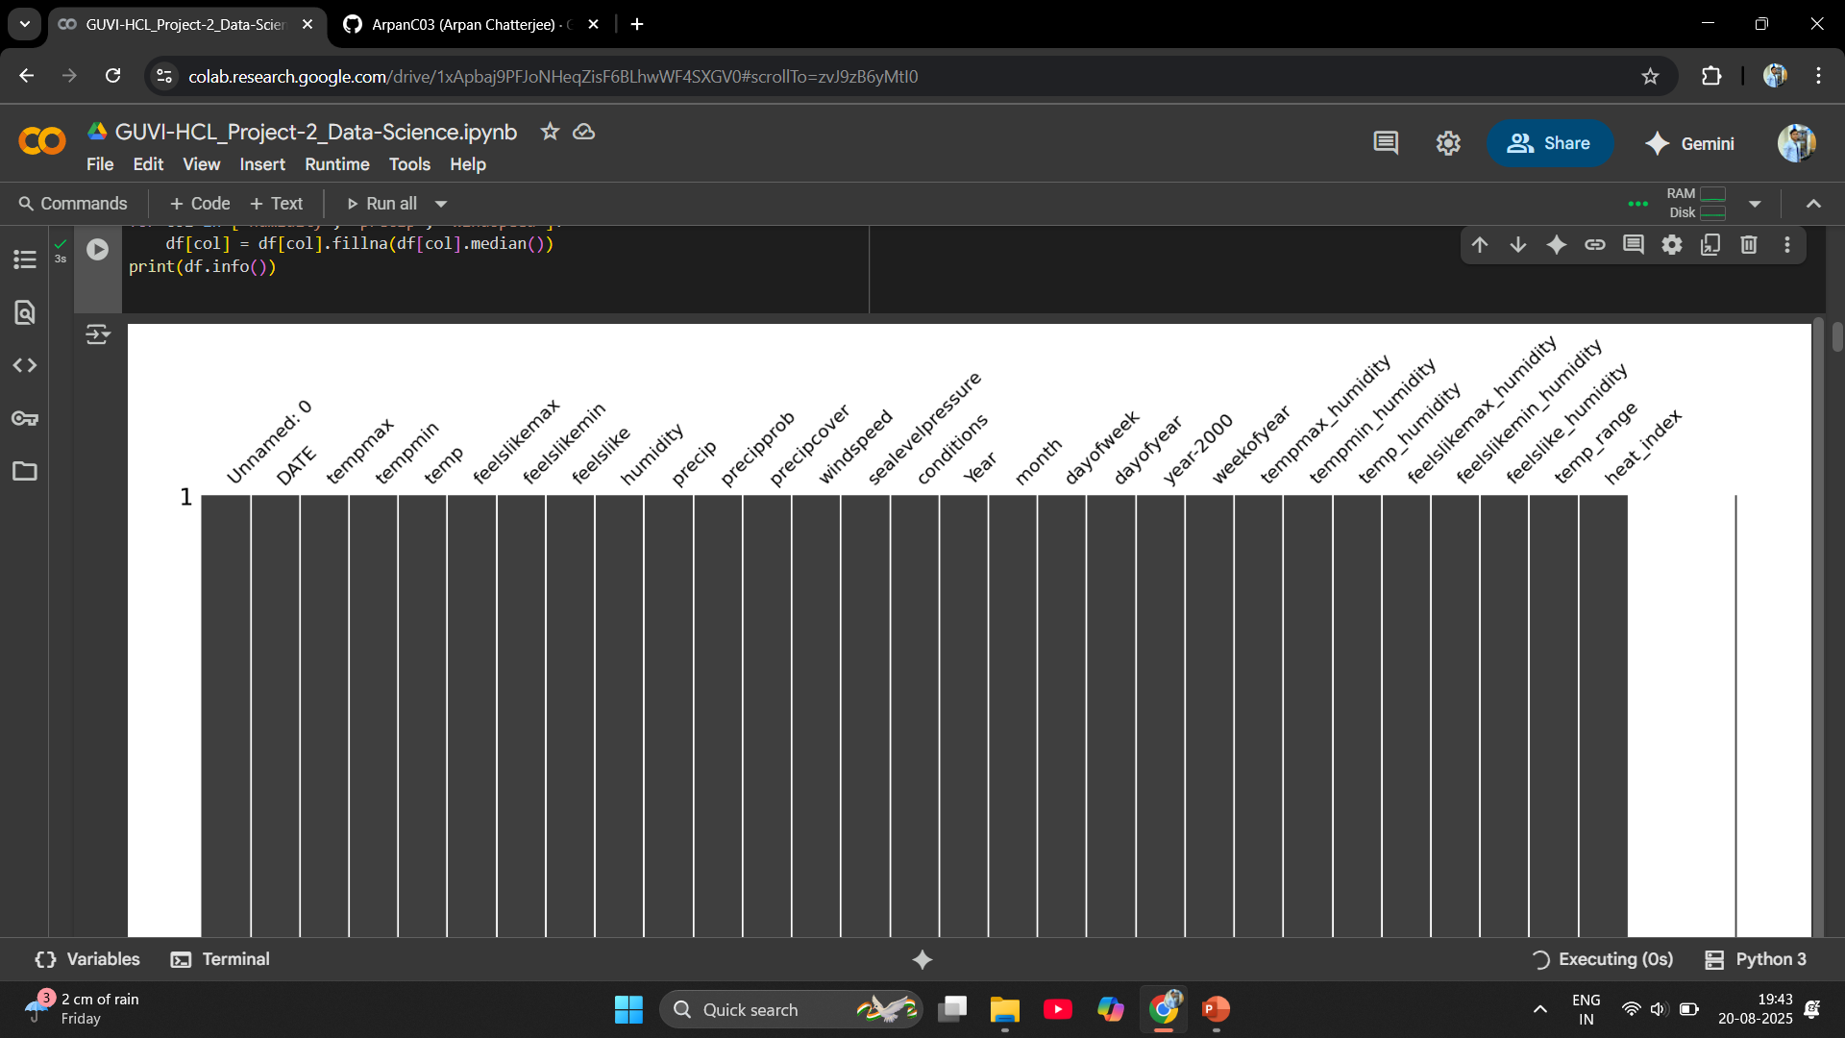
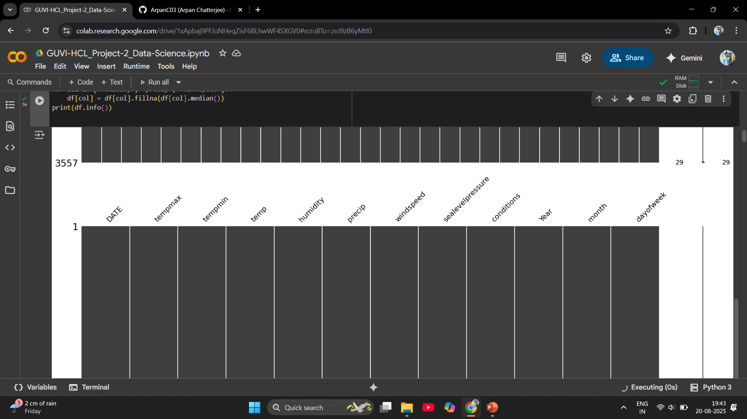
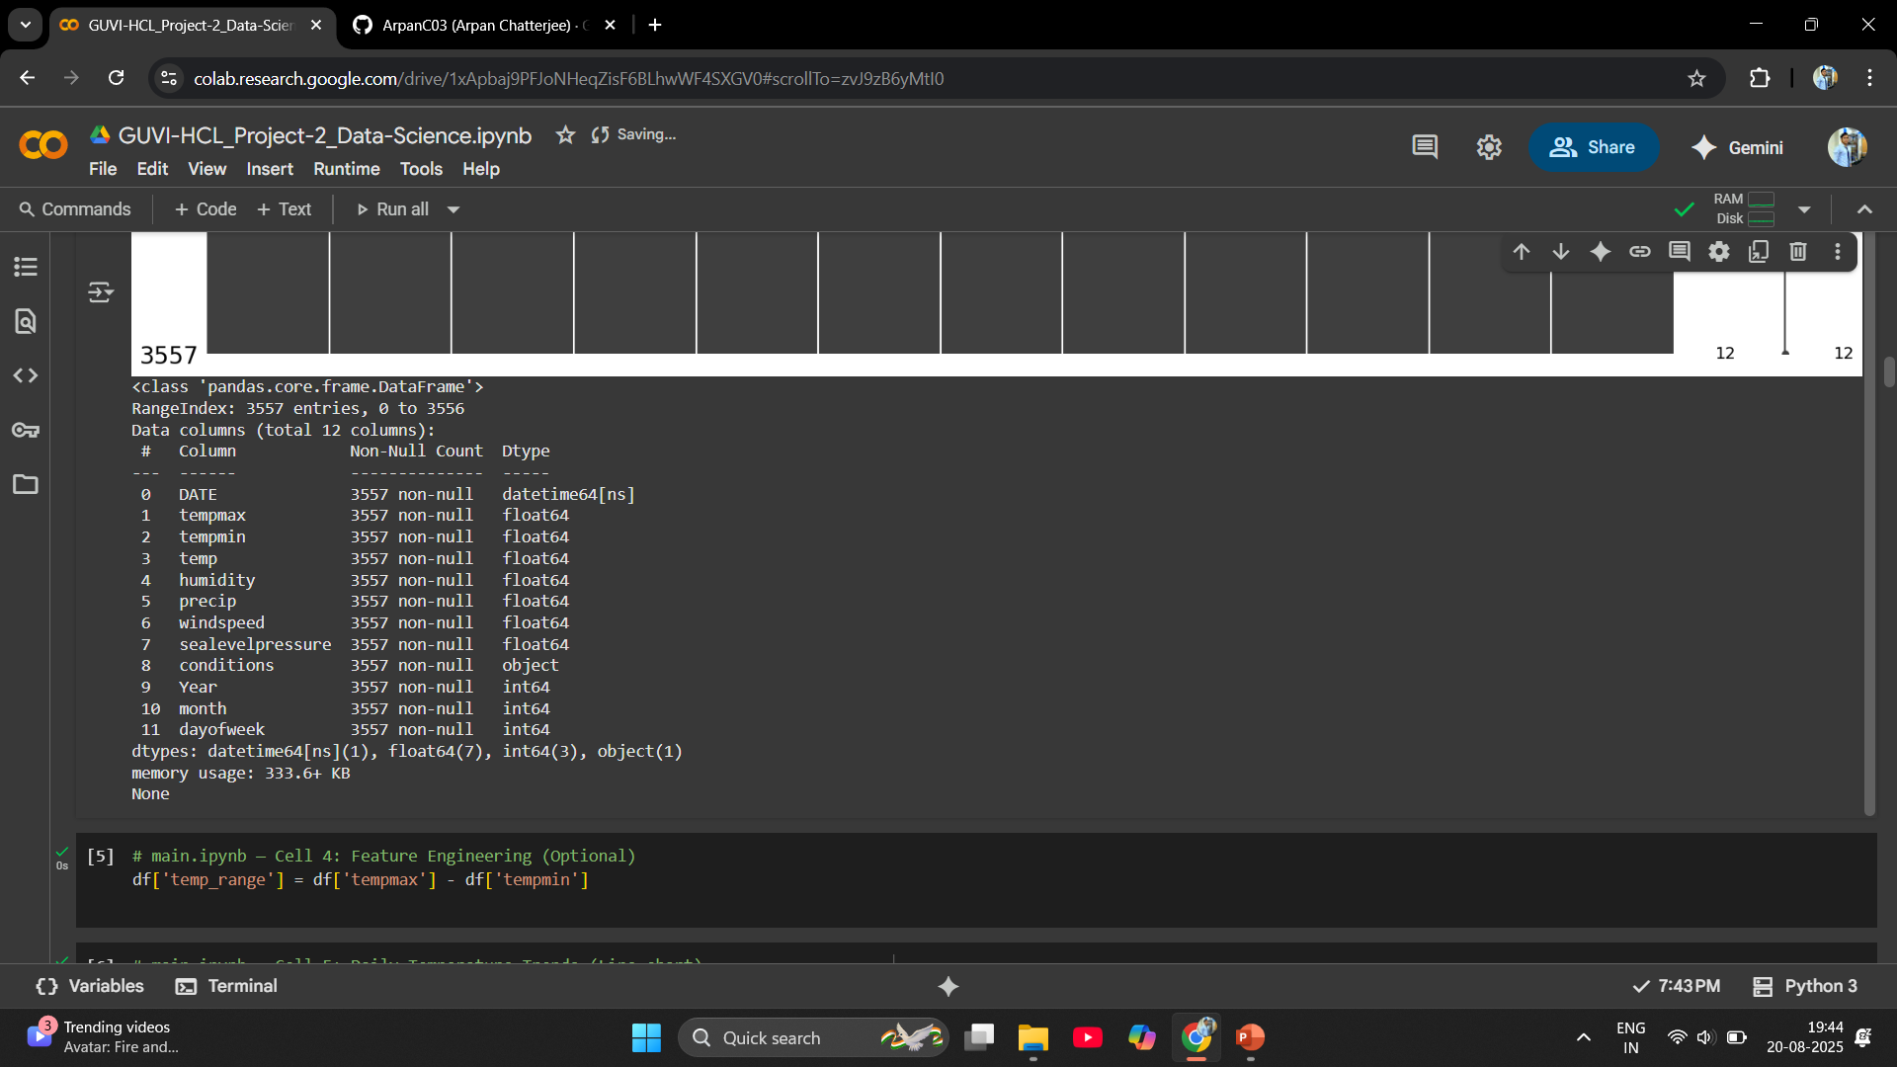

Slide 8
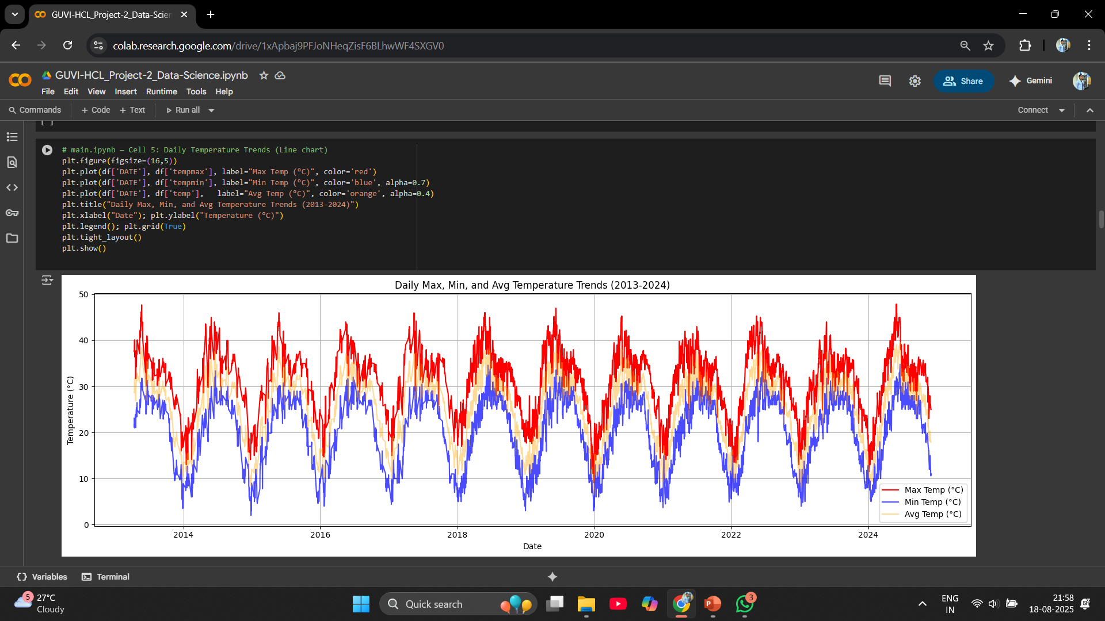
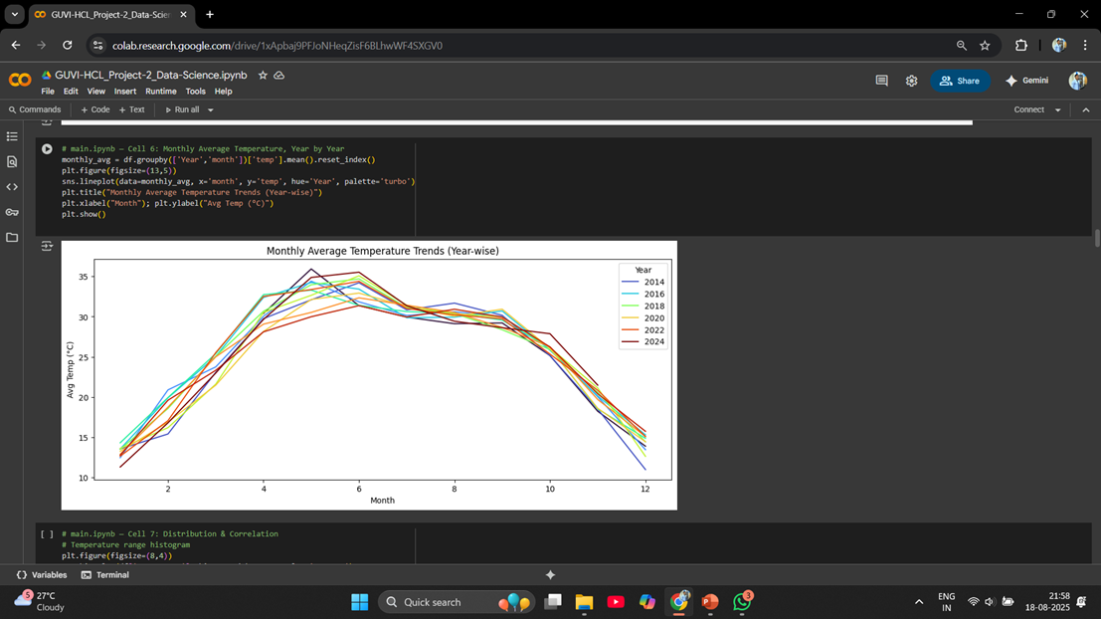
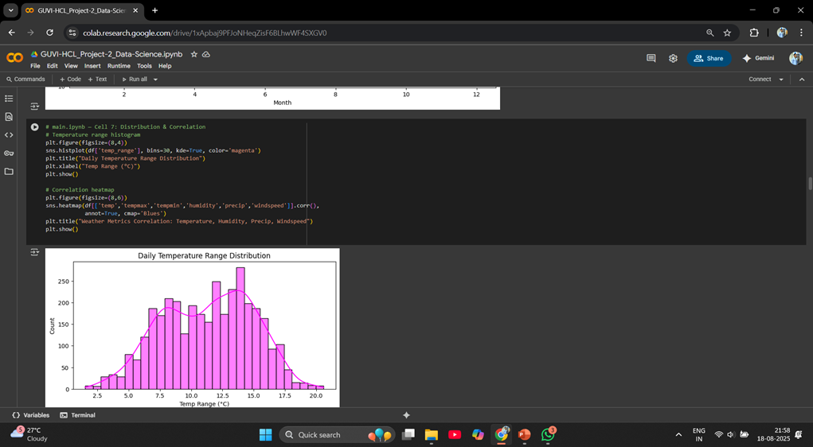
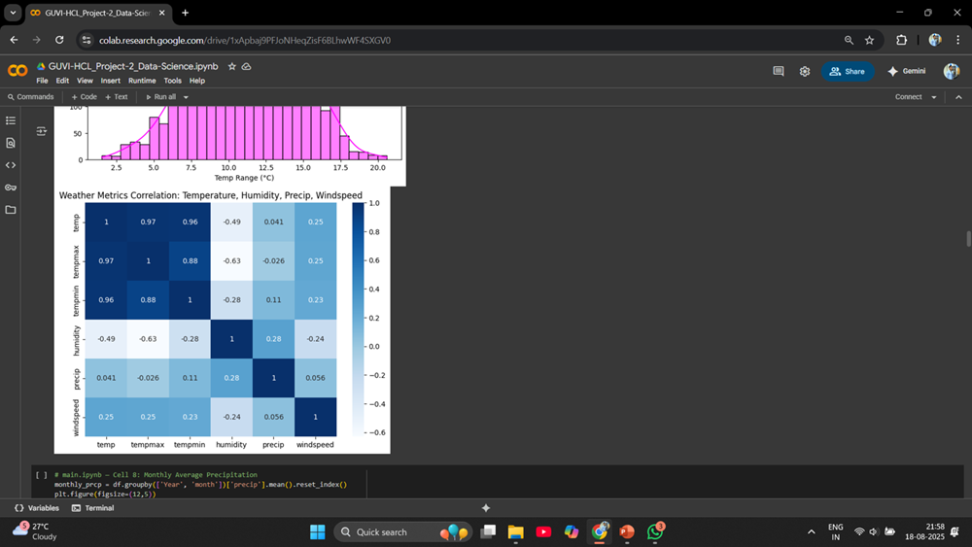

Slide 9
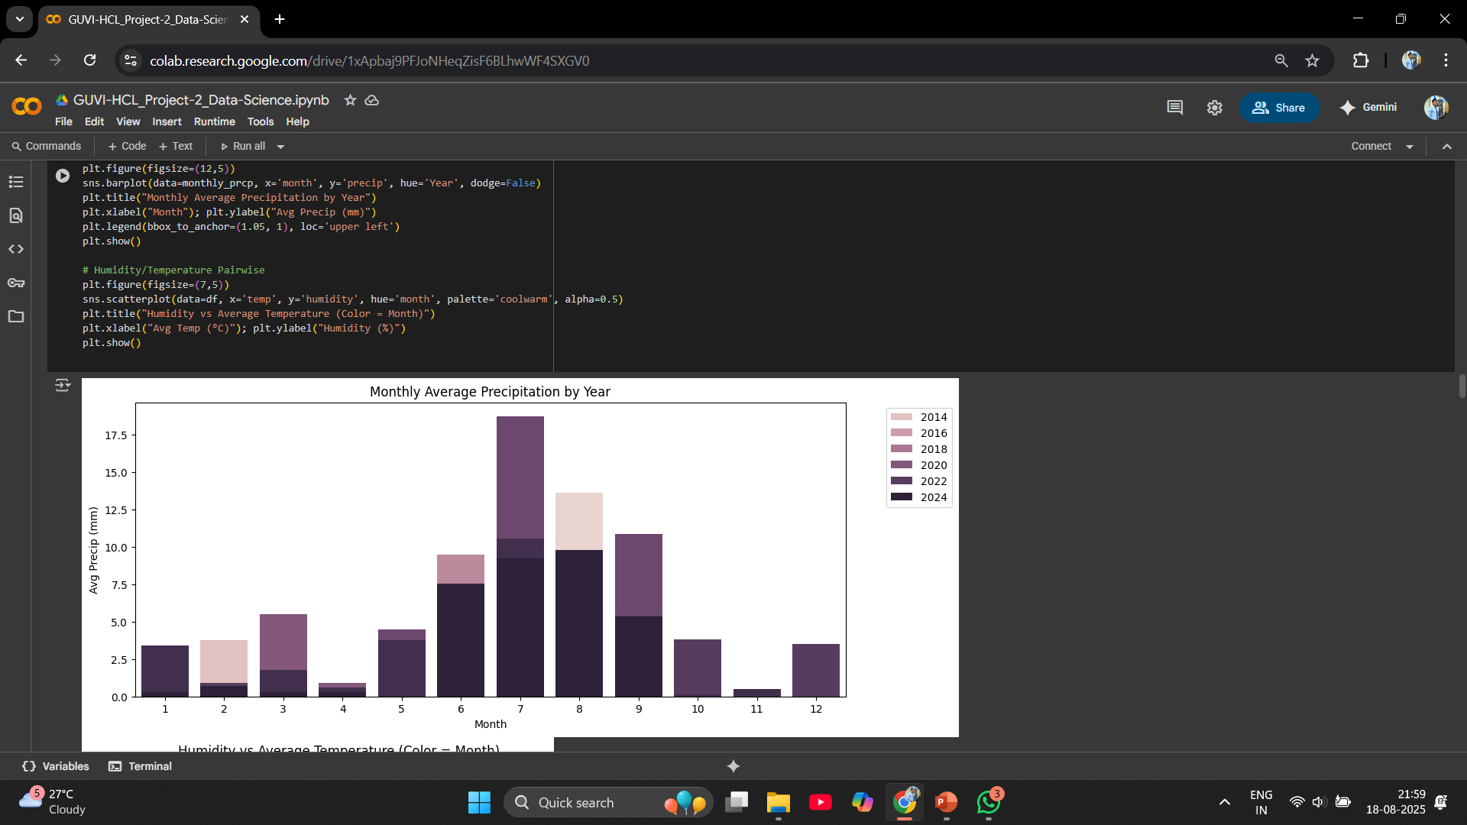
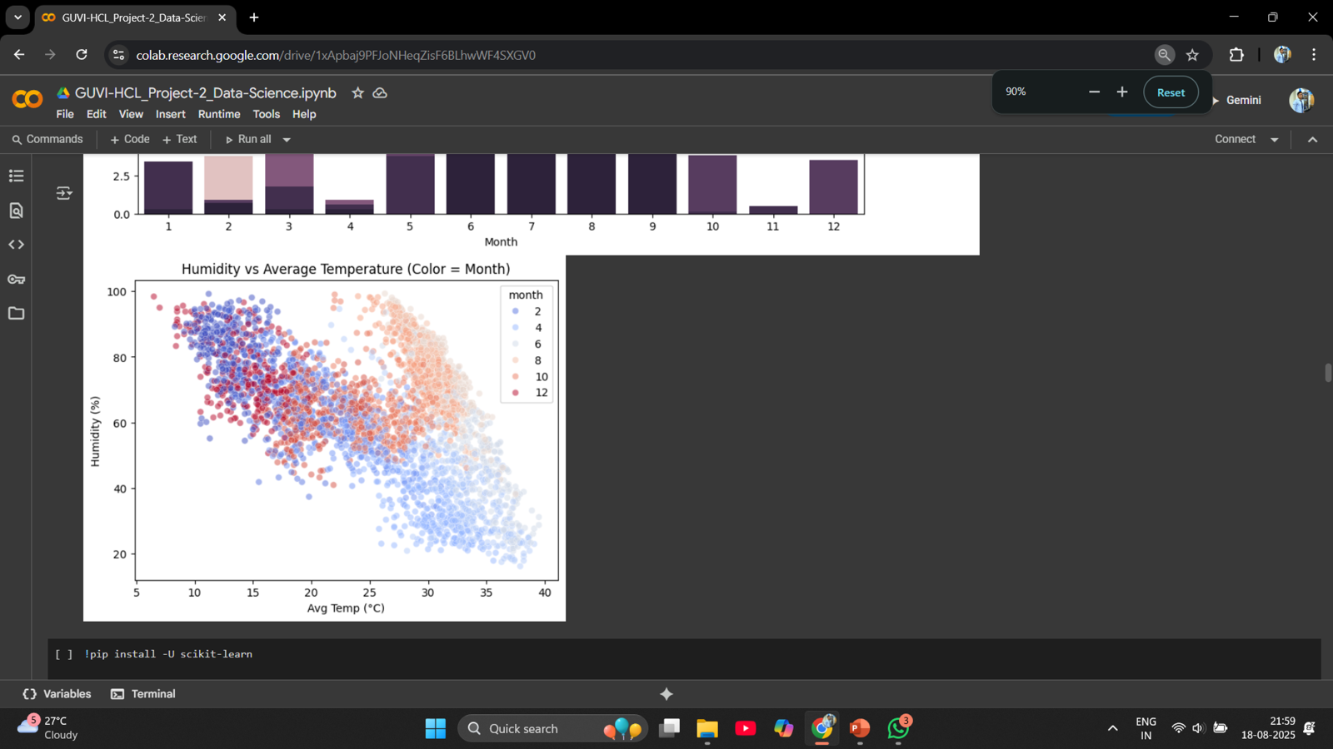
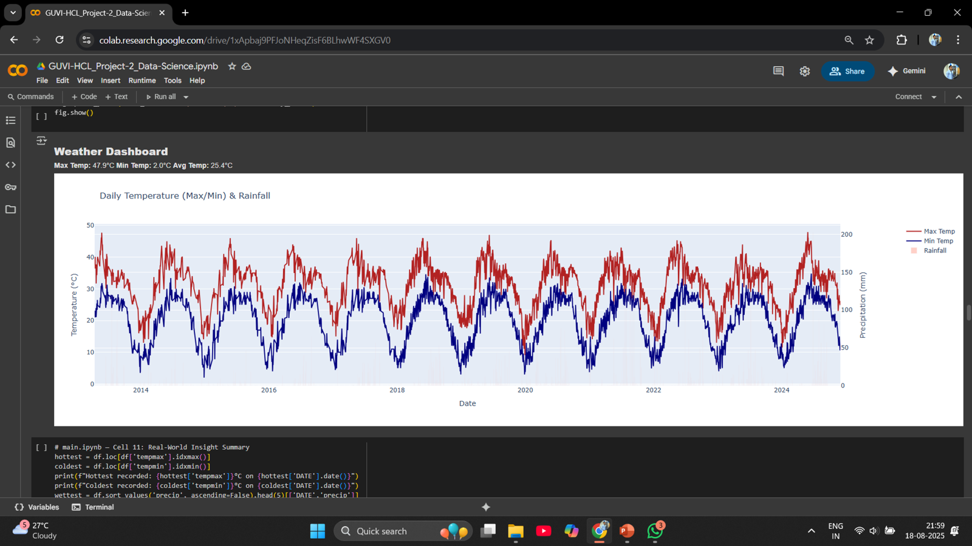
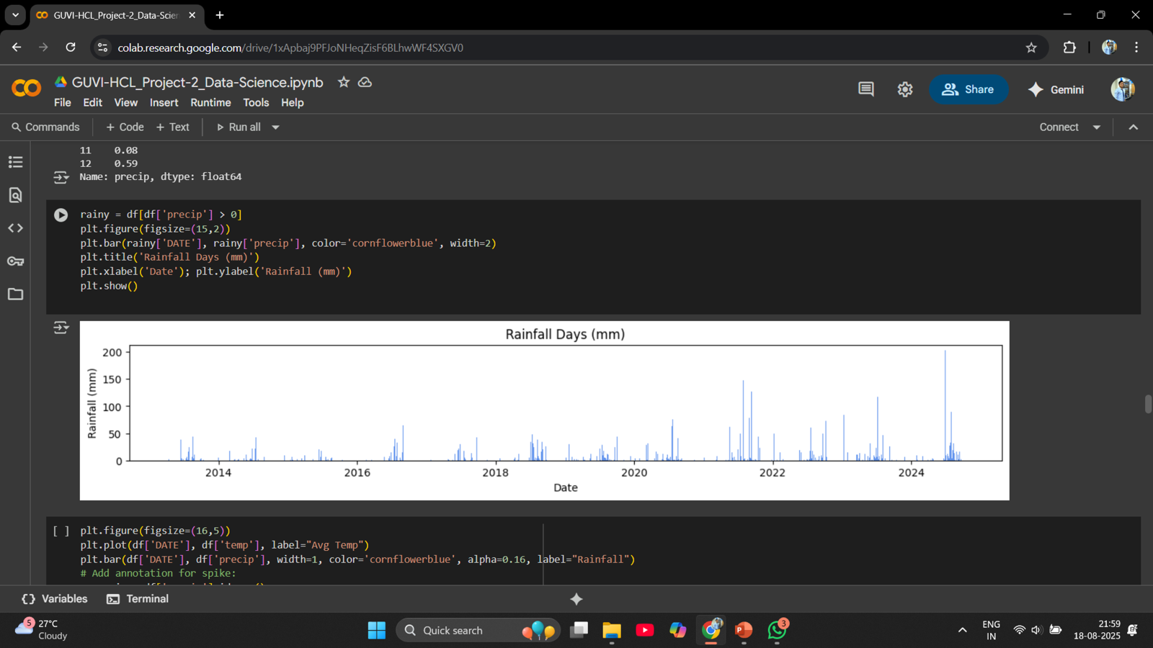

Slide 10
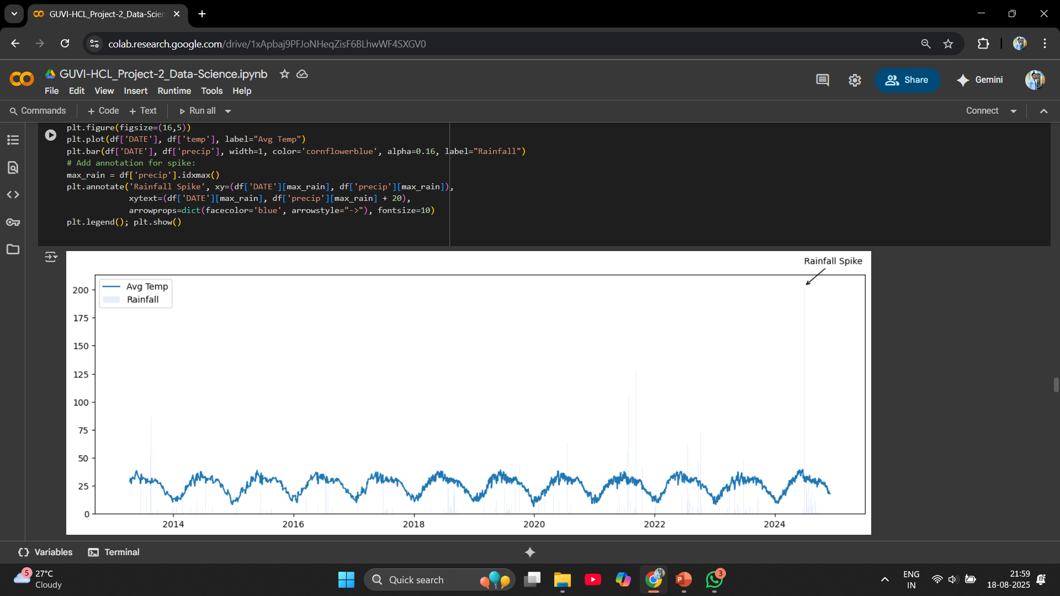
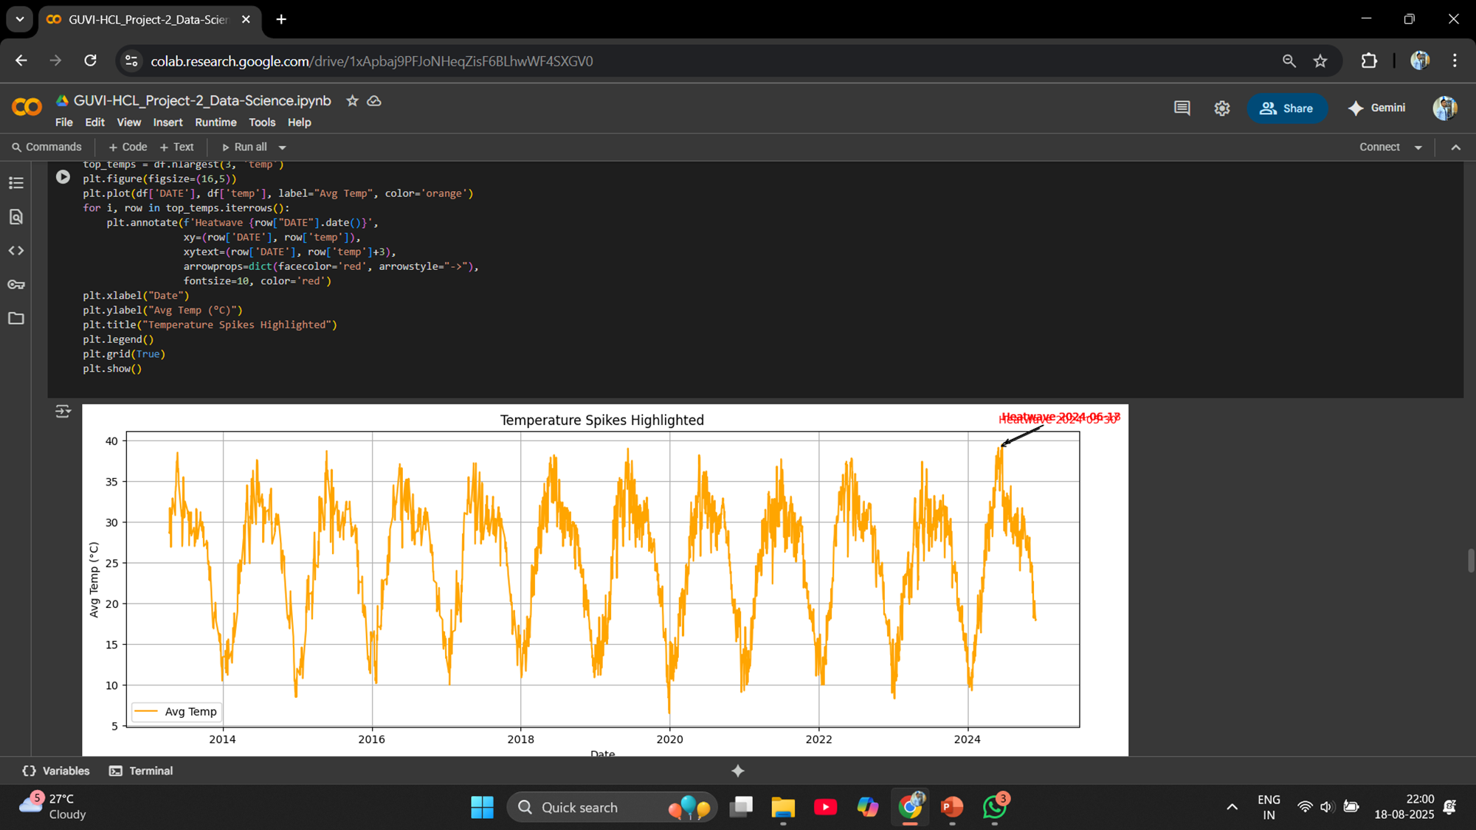
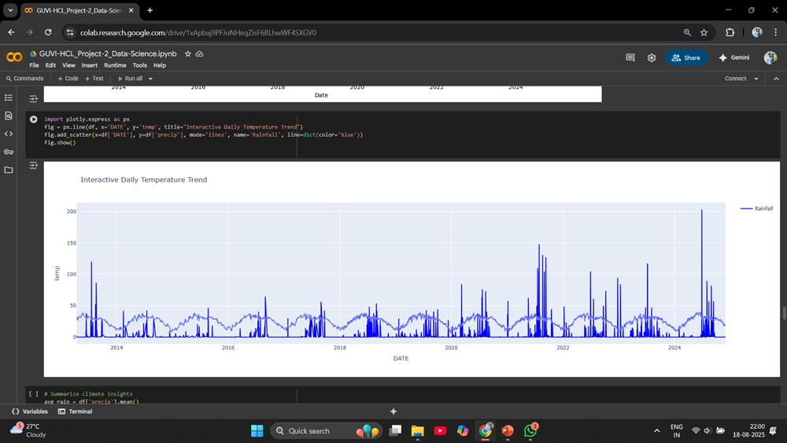
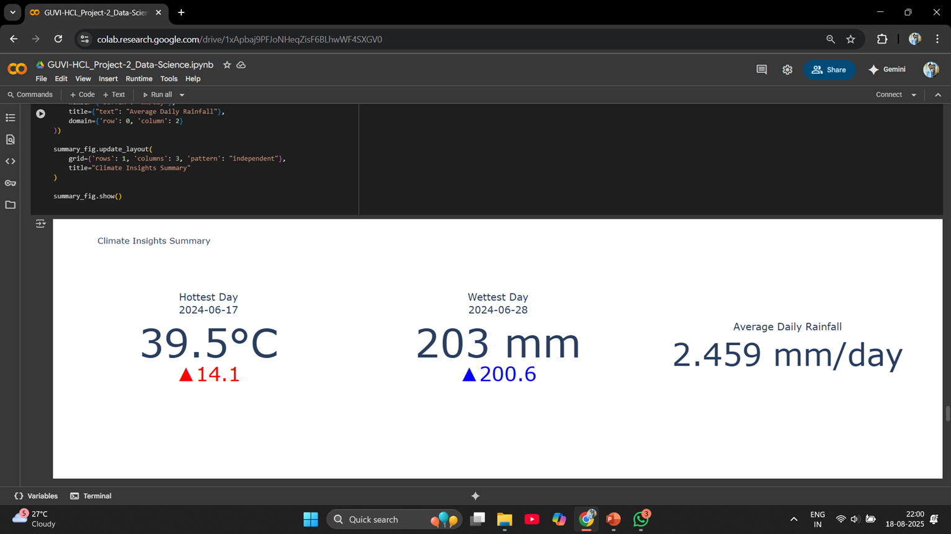

Slide 11
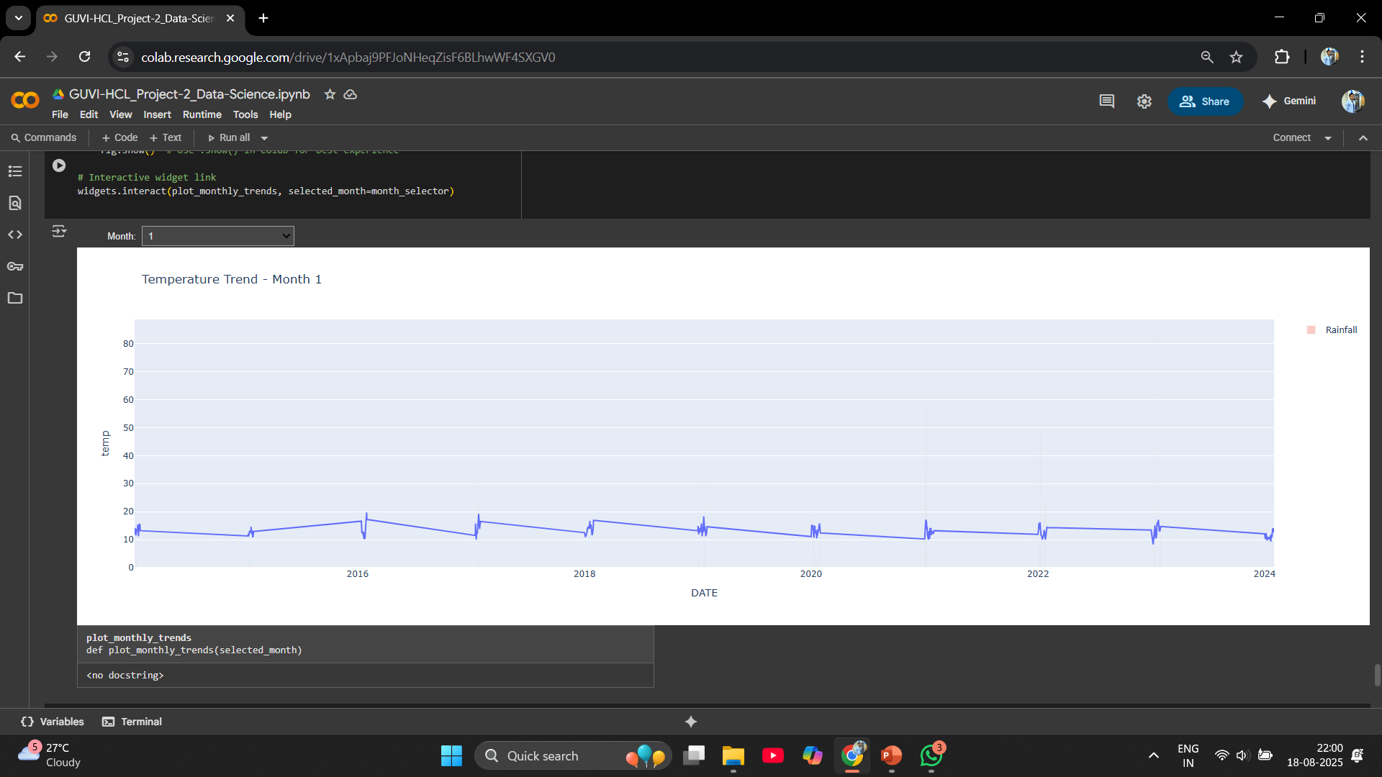
Insights from the Analysis
The generated plots provide clear evidence of seasonal weather shifts. For instance, months typically associated with summer show an upward trend in temperature and relatively minimal rainfall, whereas monsoon months feature pronounced spikes in precipitation. These visualizations enable quick identification of weather anomalies and can inform planning for agricultural cycles, outdoor activities, and resource allocation.

Slide 12
Conclusion
This project successfully demonstrates how data science techniques can transform raw meteorological data into actionable insights for a wide range of users. By collecting daily temperature and rainfall records and systematically preprocessing the data, we ensured that the subsequent analysis was both accurate and meaningful. The use of interactive tools such as Plotly and ipywidgets enabled the creation of dynamic visualizations, allowing users to explore trends month by month and gain a granular understanding of seasonal weather patterns.
The resulting visualizations highlighted clear cycles in temperature and rainfall, revealing trends such as peak summer heat and intensified monsoon precipitation. These insights are not only valuable for academic study but also have practical implications for agriculture, urban planning, event management, and personal scheduling. For instance, farmers could use these monthly patterns to optimize planting schedules, while city planners might better anticipate periods of heavy rainfall to improve infrastructure readiness.
Moreover, this approach underscores the importance of interactive, user-friendly data analysis in making complex information accessible to a broader audience. The ability to select specific months and instantly visualize changes empowers users to dig deeper into the data, uncovering correlations and anomalies that might otherwise go unnoticed in static reports or spreadsheets. Such methods foster data-driven decision-making and promote a culture of openness and exploration around environmental information.
Overall, this project highlights the critical role of data science in bridging the gap between environmental data and everyday applications. The workflow established here can be extended to other datasets or tailored to specific local needs, providing a scalable foundation for future weather analytics and decision support systems. As climate continues to impact daily life, accessible analytical tools like these will become ever more essential in helping society adapt and thrive.

